Slide 1



简单高效LaTeX Simple & Effective LaTeX
001 – 开篇和实践介绍 Opening
- GitHub address: https://github.com/yasenstar/learn_latex
- Gitee address: https://gitee.com/yasenstar/learn_latex

Slide 2
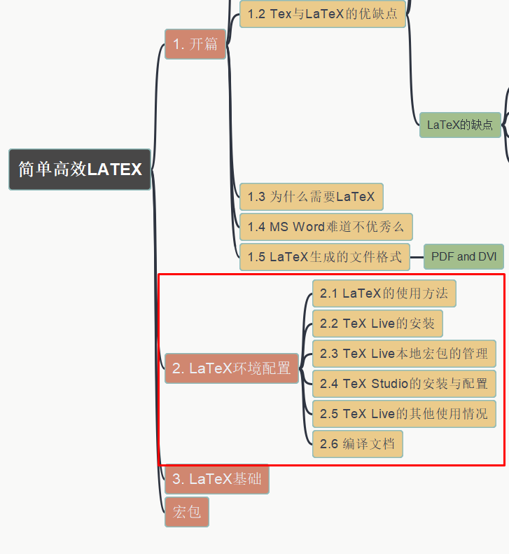
简单高效LaTeX Simple & Effective LaTeX
002 – LaTeX的环境配置
LaTeX Editing Environment Setup
- GitHub address: https://github.com/yasenstar/learn_latex
- Gitee address: https://gitee.com/yasenstar/learn_latex

Slide 3
简单高效LaTeX Simple & Effective LaTeX
003 – LaTeX的环境配置(Cont.)
LaTeX Editing Environment Setup
- GitHub address: https://github.com/yasenstar/learn_latex
- Gitee address: https://gitee.com/yasenstar/learn_latex

Slide 4
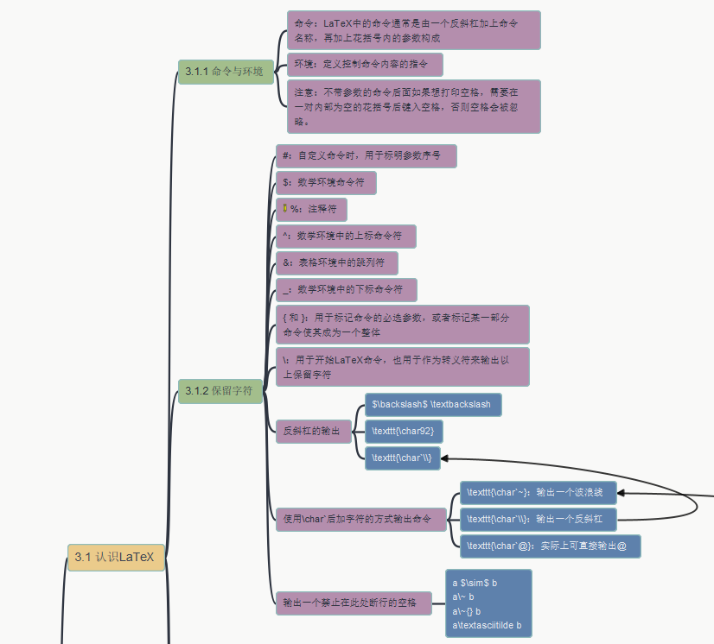
简单高效LaTeX Simple & Effective LaTeX
004 – LaTeX基础 – 3.1 认识LaTeX
3.1.1 命令与环境
3.1.2 保留字符
- GitHub address: https://github.com/yasenstar/learn_latex
- Gitee address: https://gitee.com/yasenstar/learn_latex

Slide 5
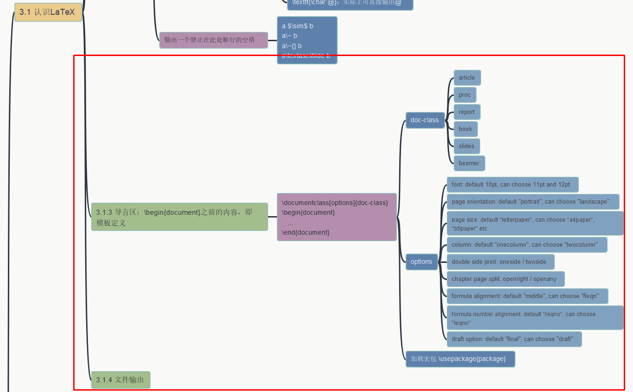
简单高效LaTeX Simple & Effective LaTeX
005 – LaTeX基础 – 3.1 认识LaTeX
3.1.3 导言区，3.1.4 文档输出
- GitHub address: https://github.com/yasenstar/learn_latex
- Gitee address: https://gitee.com/yasenstar/learn_latex

Slide 6
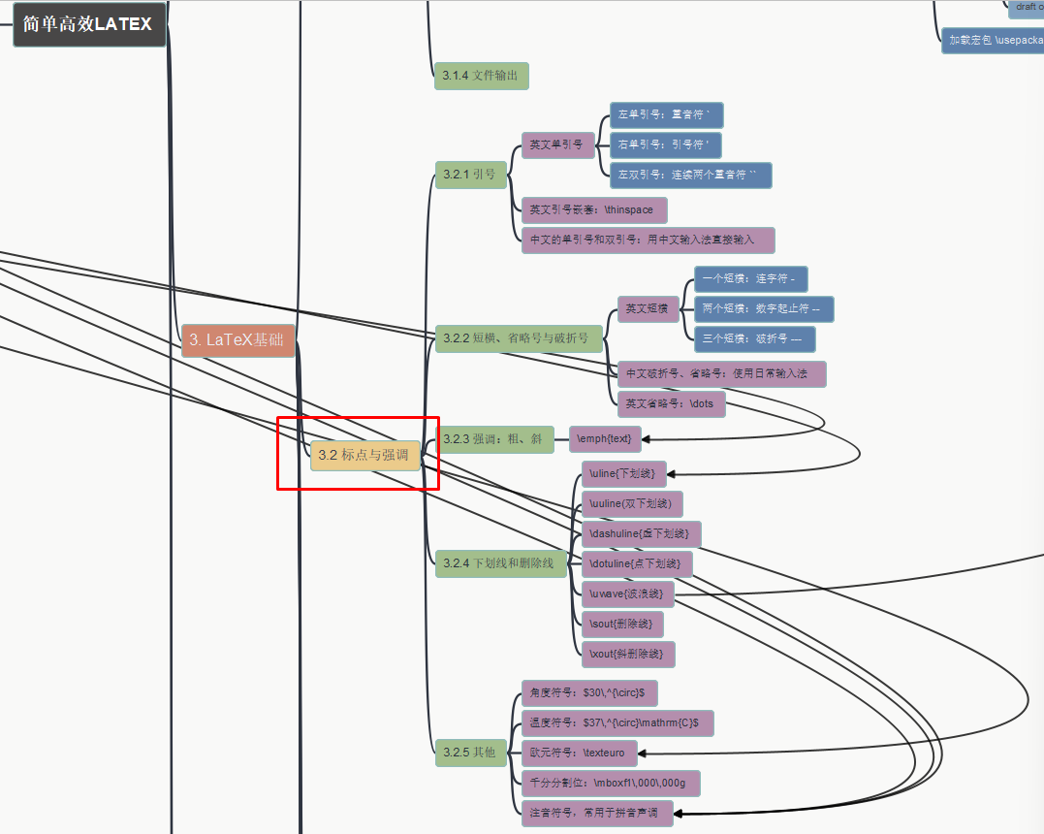
简单高效LaTeX Simple & Effective LaTeX
006 – LaTeX基础 –
3.2 标点与强调
- GitHub address: https://github.com/yasenstar/learn_latex
- Gitee address: https://gitee.com/yasenstar/learn_latex

Slide 7
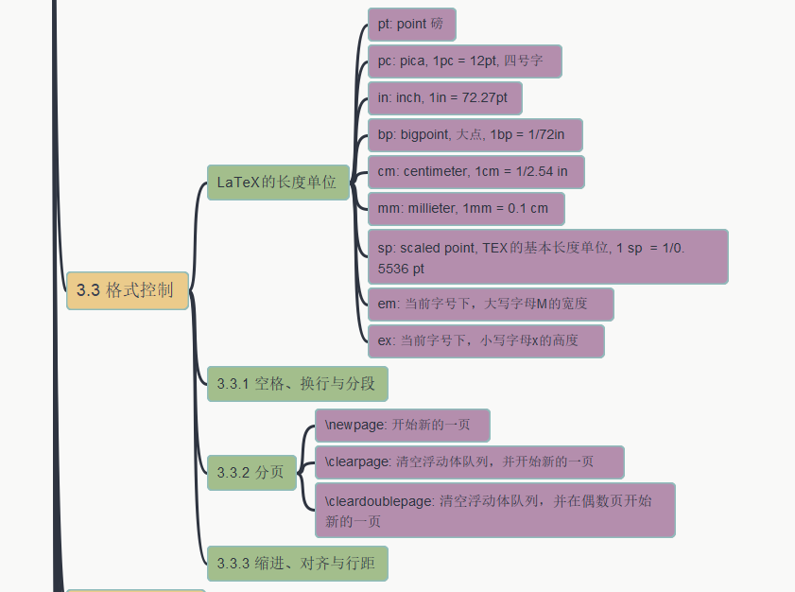
简单高效LaTeX Simple & Effective LaTeX
007 – LaTeX基础 –
3.3 格式控制
- GitHub address: https://github.com/yasenstar/learn_latex
- Gitee address: https://gitee.com/yasenstar/learn_latex

Slide 8
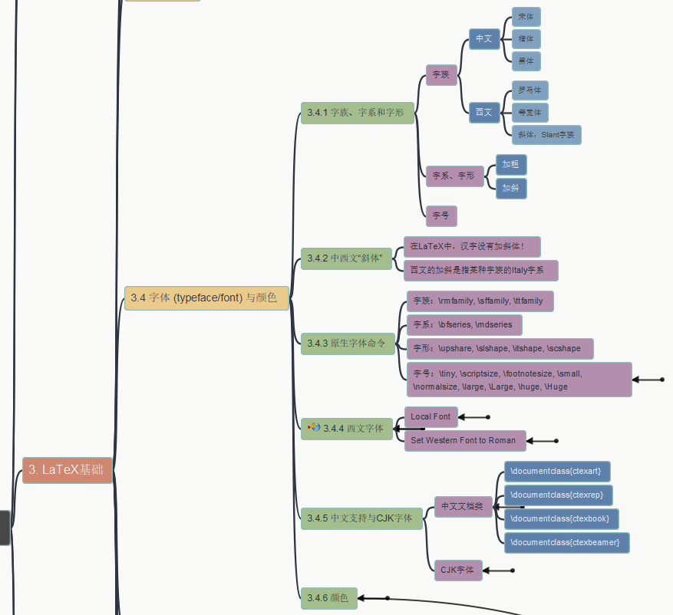
简单高效LaTeX Simple & Effective LaTeX
008 – LaTeX基础 –
3.4 字体和颜色
- GitHub address: https://github.com/yasenstar/learn_latex
- Gitee address: https://gitee.com/yasenstar/learn_latex

Slide 9
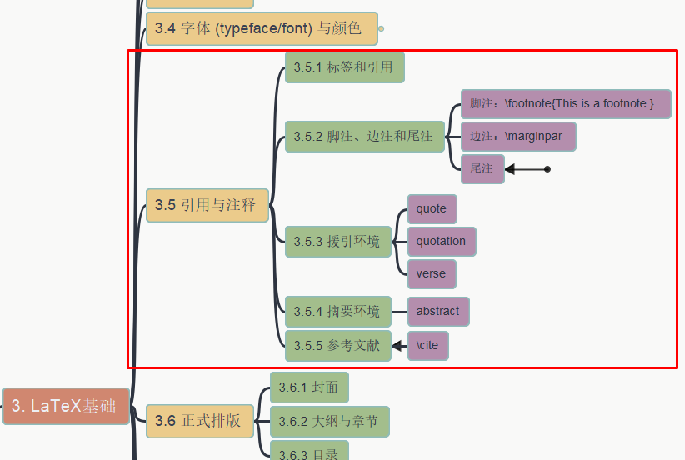
简单高效LaTeX Simple & Effective LaTeX
009 – LaTeX基础 –
3.5 引用与注释
- GitHub address: https://github.com/yasenstar/learn_latex
- Gitee address: https://gitee.com/yasenstar/learn_latex

Slide 10
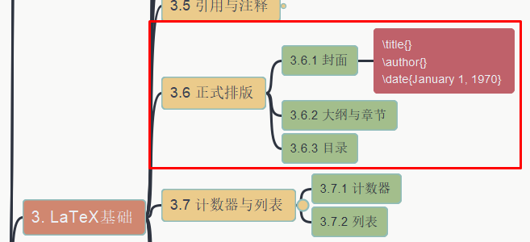
简单高效LaTeX Simple & Effective LaTeX
010 – LaTeX基础 –
3.6 正式排版
- GitHub address: https://github.com/yasenstar/learn_latex
- Gitee address: https://gitee.com/yasenstar/learn_latex

Slide 11
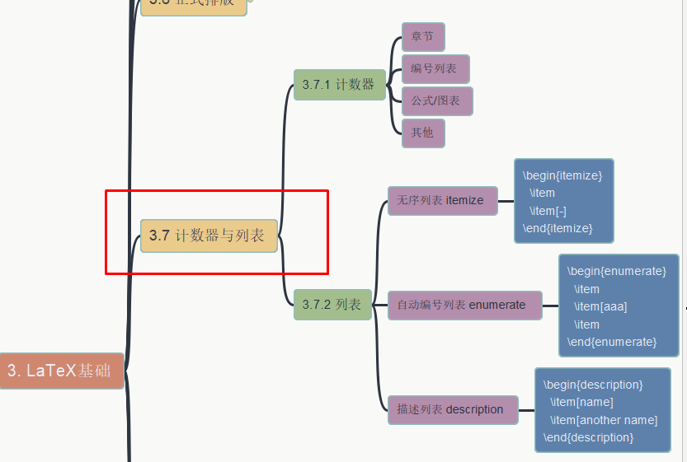
简单高效LaTeX Simple & Effective LaTeX
011 – LaTeX基础 –
3.7 计数器和列表
- GitHub address: https://github.com/yasenstar/learn_latex
- Gitee address: https://gitee.com/yasenstar/learn_latex

Slide 12
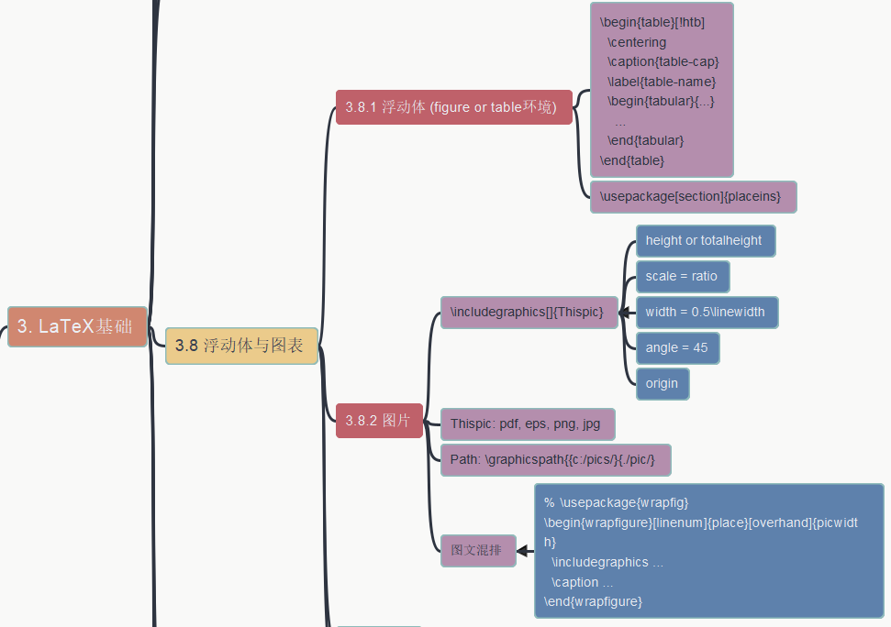
简单高效LaTeX Simple & Effective LaTeX
012 – LaTeX基础 –
3.8(1) 浮动体和图片
- GitHub address: https://github.com/yasenstar/learn_latex
- Gitee address: https://gitee.com/yasenstar/learn_latex

Slide 13
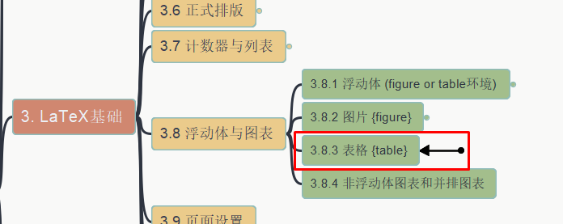
简单高效LaTeX Simple & Effective LaTeX
013 – LaTeX基础 –
3.8(2) 表格
- GitHub address: https://github.com/yasenstar/learn_latex
- Gitee address: https://gitee.com/yasenstar/learn_latex

Slide 14
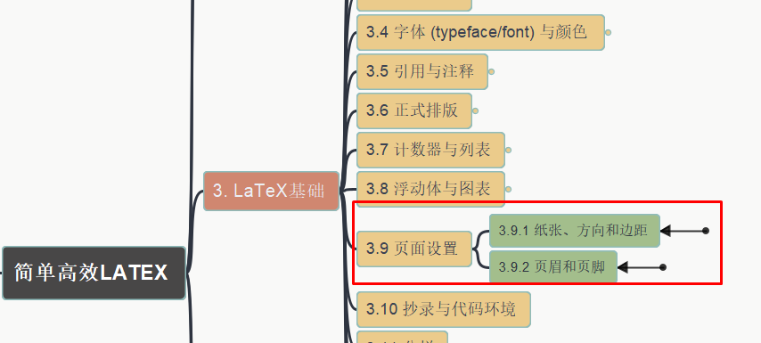
简单高效LaTeX Simple & Effective LaTeX
014 – LaTeX基础 –
3.9 页面设置
- GitHub address: https://github.com/yasenstar/learn_latex
- Gitee address: https://gitee.com/yasenstar/learn_latex

Slide 15
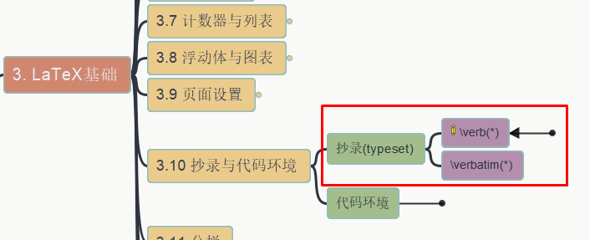
简单高效LaTeX Simple & Effective LaTeX
015 – LaTeX基础 –
3.10 抄录 typeset
- GitHub address: https://github.com/yasenstar/learn_latex
- Gitee address: https://gitee.com/yasenstar/learn_latex

Slide 16
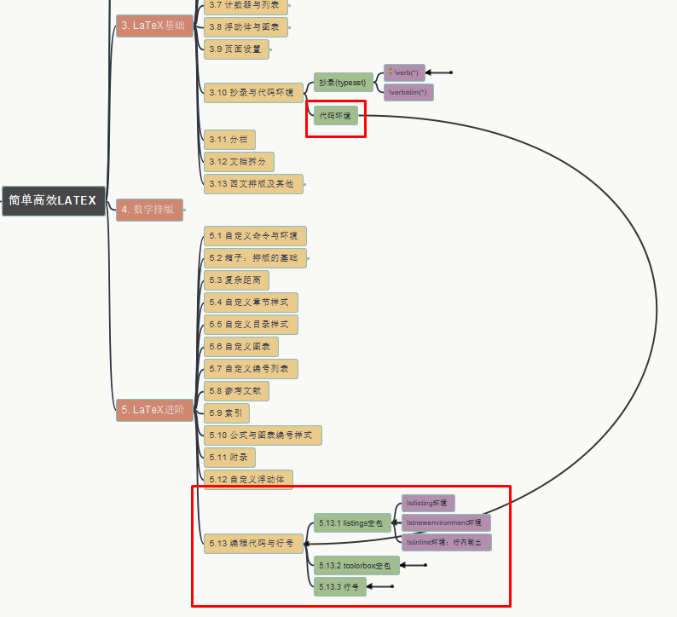
简单高效LaTeX Simple & Effective LaTeX
016 – LaTeX基础 –
3.10 代码环境
- GitHub address: https://github.com/yasenstar/learn_latex
- Gitee address: https://gitee.com/yasenstar/learn_latex

Slide 17
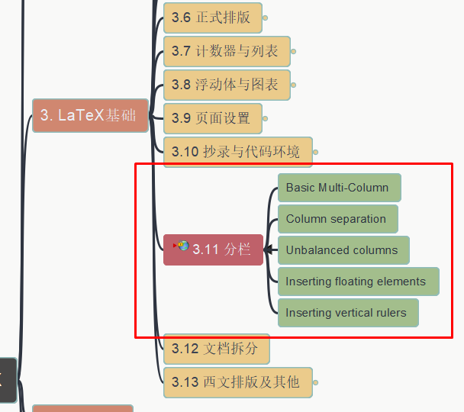
简单高效LaTeX Simple & Effective LaTeX
017 – LaTeX基础 –
3.11 分栏 Multi Column
- GitHub address: https://github.com/yasenstar/learn_latex
- Gitee address: https://gitee.com/yasenstar/learn_latex

Slide 18
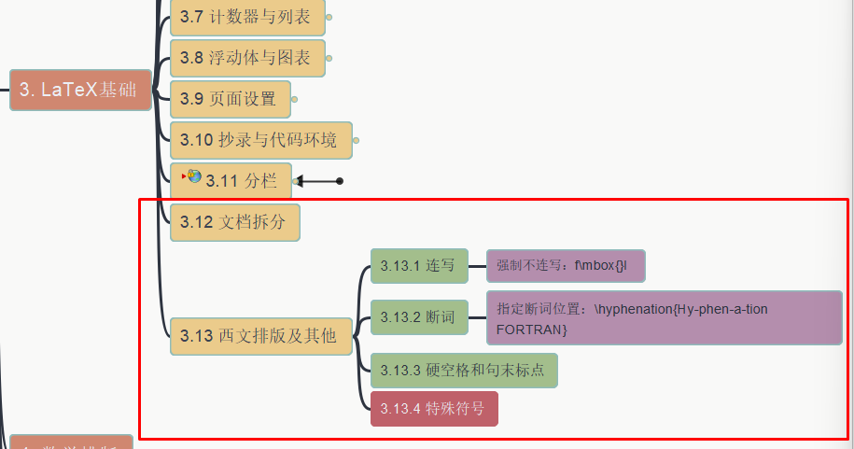
简单高效LaTeX Simple & Effective LaTeX
018 – LaTeX基础 –
3.12 文档拆分
3.13 西文排版和其他
- GitHub address: https://github.com/yasenstar/learn_latex
- Gitee address: https://gitee.com/yasenstar/learn_latex

Slide 19
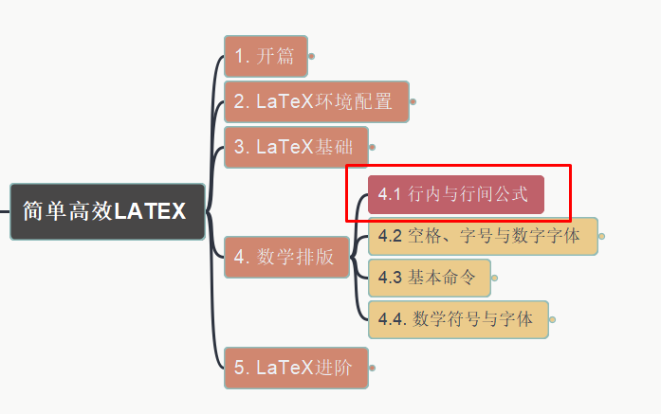
简单高效LaTeX Simple & Effective LaTeX
019 – LaTeX基础 –
4 数学排版
4.1 行内和行间公式
- GitHub address: https://github.com/yasenstar/learn_latex
- Gitee address: https://gitee.com/yasenstar/learn_latex

Slide 20
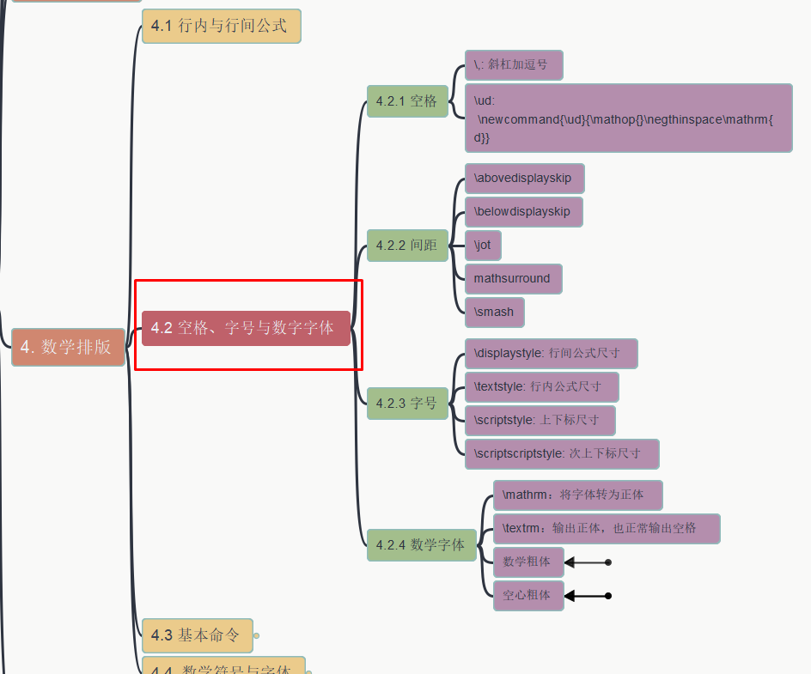
简单高效LaTeX Simple & Effective LaTeX
020 – LaTeX基础 –
4 数学排版
4.2 空格 字号 数学字体
- GitHub address: https://github.com/yasenstar/learn_latex
- Gitee address: https://gitee.com/yasenstar/learn_latex

Slide 21
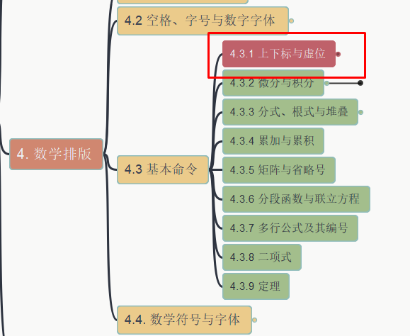
简单高效LaTeX Simple & Effective LaTeX
021 – LaTeX基础 –
4 数学排版
4.3 基本数学命令-1
4.3.1 上下标与虚位
- GitHub address: https://github.com/yasenstar/learn_latex
- Gitee address: https://gitee.com/yasenstar/learn_latex

Slide 22
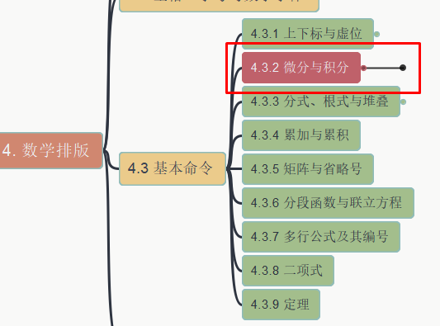
简单高效LaTeX Simple & Effective LaTeX
022 – LaTeX基础 –
4 数学排版
4.3 基本数学命令-2
4.3.2 微分与积分
- GitHub address: https://github.com/yasenstar/learn_latex
- Gitee address: https://gitee.com/yasenstar/learn_latex

Slide 23
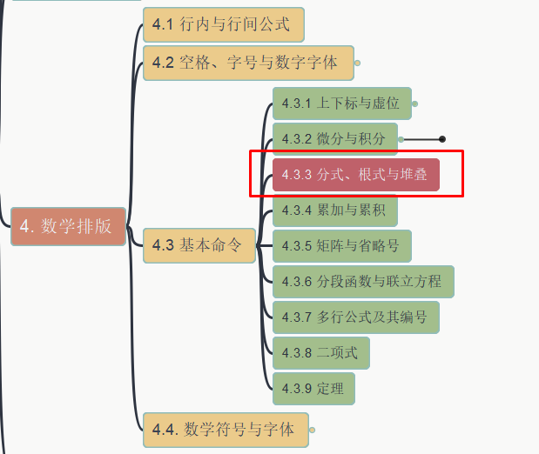
简单高效LaTeX Simple & Effective LaTeX
023 – LaTeX基础 –
4 数学排版
4.3 基本数学命令-3
4.3.3 分式 根式 堆叠
- GitHub address: https://github.com/yasenstar/learn_latex
- Gitee address: https://gitee.com/yasenstar/learn_latex

Slide 24
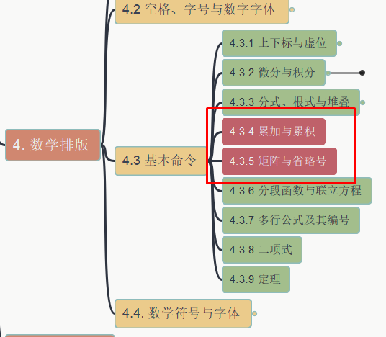
简单高效LaTeX Simple & Effective LaTeX
024 – LaTeX基础 –
4 数学排版
4.3 基本数学命令-4
4.3.4 累加和累积
4.3.5 矩阵和省略号
- GitHub address: https://github.com/yasenstar/learn_latex
- Gitee address: https://gitee.com/yasenstar/learn_latex

Slide 25
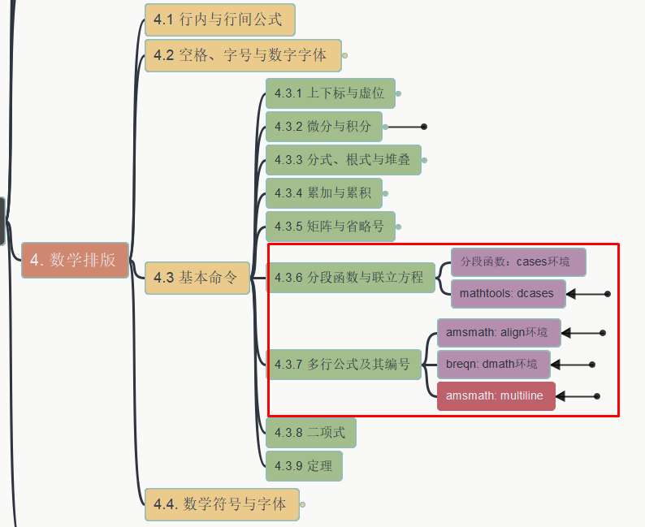
简单高效LaTeX Simple & Effective LaTeX
025 – LaTeX基础 –
4 数学排版
4.3 基本数学命令-4
4.3.6 分段函数和联立方程
4.3.7 多行公式和编号
- GitHub address: https://github.com/yasenstar/learn_latex
- Gitee address: https://gitee.com/yasenstar/learn_latex

Slide 26
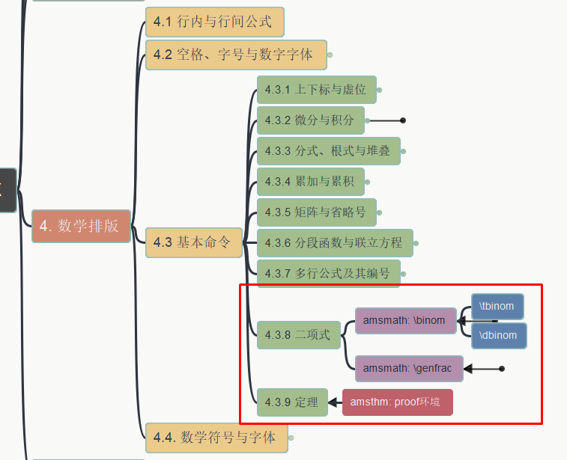
简单高效LaTeX Simple & Effective LaTeX
026 – LaTeX基础 –
4 数学排版
4.3 基本数学命令-4
4.3.8 二项式 4.3.9 定理
- GitHub address: https://github.com/yasenstar/learn_latex
- Gitee address: https://gitee.com/yasenstar/learn_latex

Slide 27




